Slide 1
Sentiments of AI Tweets in June 2018
Rosalie Day

Slide 2
Analysis of Sentiments about Artificial Intelligence

Slide 3
Introduction - Sentiment analysis on Twitter data
This is an Rmarkdown presentation for an analysis of tweets related to artificial intelligence.
Data set is an extraction of free Twitter data for 7-day period in June, 2018. (NOTE: Twitter data policy changed to a more limited free data extraction than was intended in the proposal. Project was intended to gauge general public sentiments.)
Tidyverse, rtweet, qdapRegex, tidytext and wordcloud packages used.

Slide 4
Sample tweet texts in English
## [1] "supercomputing artificialintelligence skills our new digital europe programme will shape europe's digital transformation to the benefit of citizens and businesses today we will present our eubudget proposals on digital europe outline explained" ## [2] "our artificialintelligence polling firm polly says 35 of voters are talking about the renataford controversy with 74 feeling more negative about fordnation because of it 21 are defending ford and 5 neutral no idea about fx on seat count onpoli election2018" ## [3] "ok here's a question for narendramodi how do you promote excellence in india including in artificialintelligence etc while depressing the standards dramatically for half the population in college and in govt jobs seems you're setting india up for a huge fall"

Slide 5
Initial tokenization, word count, first custom stop words list applied
## Joining, by = "word"
## # A tibble: 11,372 x 2 ## word n ## <chr> <int> ## 1 rt 6602 ## 2 machinelearning 1375 ## 3 gt 755 ## 4 bigdata 752 ## 5 future 685 ## 6 read 653 ## 7 business 652 ## 8 amp 594 ## 9 3 506 ## 10 artificial 479 ## # ... with 11,362 more rows

Slide 6
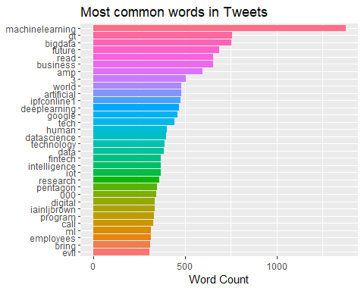
Frequent words, criteria selection words and “rt” omitted

Slide 7
Initial word count reveals
Some non-English characters
Technical jargon word pairs would not contribute to sentiment analysis, but singly they may. For example, “learning” may contribute positively, but “deep learning” should not be included.
To render the most sentiment information, further data preparation needs to include preserving the unpaired words of technical jargon pairs.

Slide 8
Tweet data preparation
Iterations of word clouds and custom stop words lists produce text data for sentiment analysis
Final list: “artificialintelligence”, “ai”, “rt”, “gt”, “amp”, “machinelearning”, “deeplearning”, “bigdata”, “datascience”, “apple”, “microsoft”, “ibm”, “amazon”, “ipfconline1”, “quindazzi”, “mckinsey”, “mit”, “iainljbrown”, “nitiaayog”, “vanloon”, “google”,“ronald”, “apple’s”, “forbes”, “blockchain”, “mozilla”, “deeplearn007”, “thomas1774paine”, “3”, “000”, “1”, “5”, “10”, “12”, “2018”, “2”, “tech”, “ml”, “dl”, “pentagon”, “digitaltransformation”, “mgi”, “weftrends”, “india”, “europe”,“iot”, “software”, “cybersecurity”, “hr”, “fintech”, “deepaerodrones”, “mikequindazzi”, “thenextweb”, “valaafshar”

Slide 9
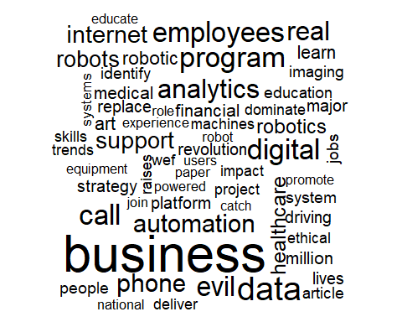
Most frequent words - ready for sentiment analysis

Slide 10
Sentiment Analysis

Slide 11
Tidyverse contains reference lexicons for word sentiment
On the corpus, composed of sentiment words in all tweet texts (tweets);
Characterizing users’ tweets as postive or negative with data grouped by user; and
Using bigrams for context, especially for negating sentiments.
NOTE: No AI news events proceeding or during data period; hence, my assumption, tweets are by users who routinely tweet about AI, which implies some technical knowledge.

Slide 12
Using three lexicons as analytical tools
Bing - binary, positive & negative sentiments
NRC - binary, positive & negtive and specific sentiments (not mutually exclusive)
AFINN - ordinal, scores range from -5 to 5

Slide 13
Sentiments of single words in corpus of tweets

Slide 14
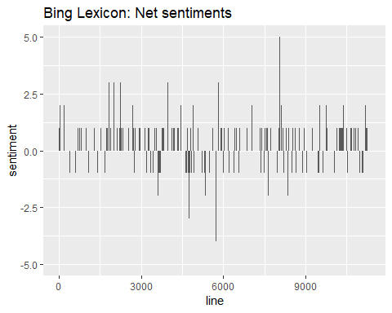
Net sentiment of corpus by word using Bing

Slide 15
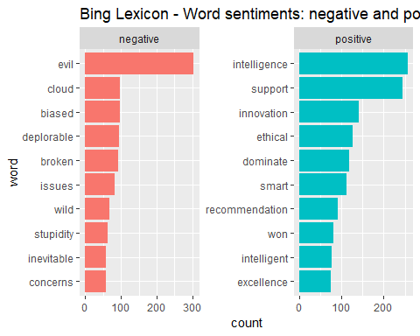
Ten most-used Bing positive and negative words

Slide 16
Using the NRC lexicon
NRC has ten sentiments:
general positive and negative, mutually exclusive like Bing;
specific descriptors - anger, anticipation, disgust, fear, joy, sadness, surprise. and trust; and
words can be associated with multiple specific sentiments

Slide 17
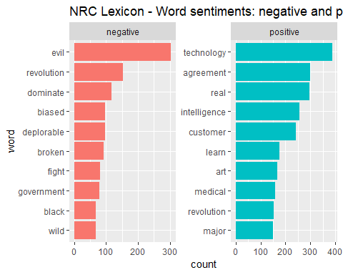
Top words expressing general sentiments

Slide 18
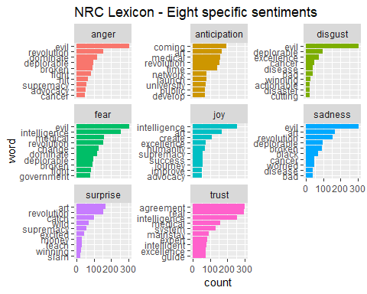
Comparing top word frequencies across specific sentiments

Slide 19
Top sentiments are trust and fear
## Selecting by n
## # A tibble: 6 x 3 ## # Groups: sentiment [2] ## word sentiment n ## <chr> <chr> <int> ## 1 agreement trust 300 ## 2 broken fear 92 ## 3 change fear 127 ## 4 deplorable fear 96 ## 5 dominate fear 118 ## 6 evil fear 304

Slide 20
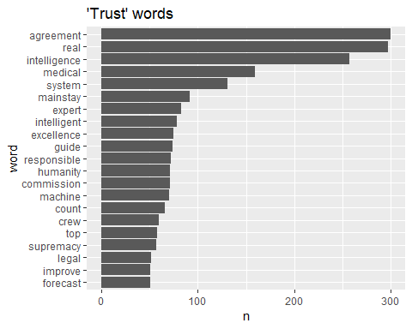
Top 20 trust words

Slide 21
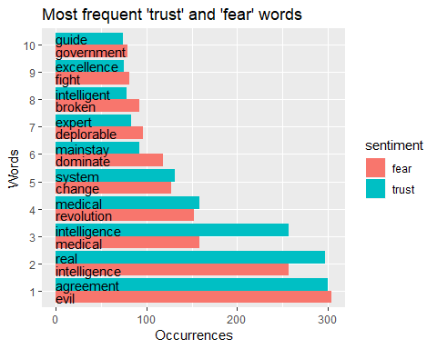
Pair-wise comparisons for frequent trust and fear words

Slide 22
Ambiguous word observations
Neutralizing effect on counts; “intelligence” in top 3 of both trust and fear, but cannot be interpreted as cancelling each other out in actual meaning.
“Medical” in top word counts of both; highlights lack of context.
Unambiguous word, “evil,” most frequently occurring, yet runs counter to overall positivity of the corpus.

Slide 23
Characterizing Tweeters’ sentiments

Slide 24
Using the AFINN lexicon to score word sentiments
The Tweeted words separated by author (user_id) may provide a more meaningful sentiment analysis to single word analysis in the corpus.
AFINN provides more information on individual words, with a range of scores -5 to 5, negative to positive.
Net sentiment of the user (= total score) can be positive or negative, and is subject to word counts and relative degree of scores of a particular user.

Slide 25
Words and aggregated scores specific to authors
## Joining, by = "word" ## Joining, by = "word"
## # A tibble: 6 x 2 ## # Groups: user_id [6] ## user_id totalID_score ## <chr> <int> ## 1 157981564 4 ## 2 16311530 -1 ## 3 416857073 14 ## 4 907905634770804736 6 ## 5 48030925 4 ## 6 29753422 2

Slide 26
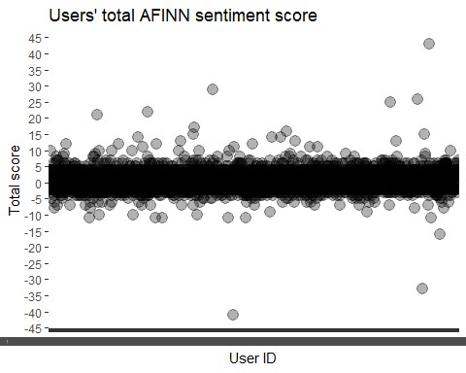
Users’ net sentiment scores tightly clustered

Slide 27
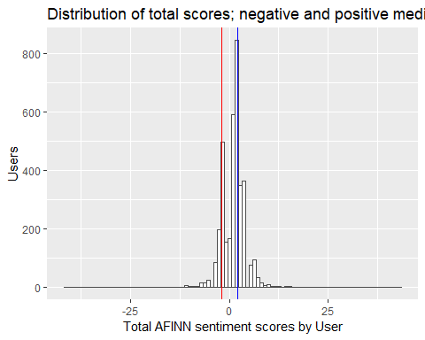
Bimodal - positive net sentiments exceed negative Tweeters

Slide 28
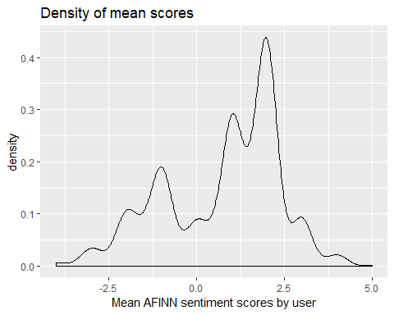
Average sentiment scores by user confirms more positive Tweeters

Slide 29
Bigrams, Word-Pair Occurrences

Slide 30
Word pairs occurring most frequently in the corpus
## # A tibble: 44,760 x 2 ## bigram n ## <chr> <int> ## 1 artificialintelligence and 840 ## 2 of the 629 ## 3 of artificialintelligence 593 ## 4 artificialintelligence to 587 ## 5 in the 554 ## 6 artificialintelligence in 544 ## 7 the future 506 ## 8 and artificialintelligence 468 ## 9 how artificialintelligence 453 ## 10 read more 451 ## # ... with 44,750 more rows

Slide 31
Separating bigrams allows for filtering and selecting
## # A tibble: 12,683 x 3 ## word1 word2 n ## <chr> <chr> <int> ## 1 employees call 296 ## 2 program evil 296 ## 3 business support 167 ## 4 process automation 161 ## 5 robotic process 159 ## 6 industrial revolution 131 ## 7 medical imaging 122 ## 8 deliver real 114 ## 9 gal deplorable 96 ## 10 internet users 94 ## # ... with 12,673 more rows

Slide 32
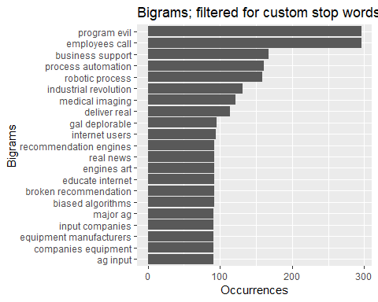
Uniting the top bigrams

Slide 33
Mix of neutral, positve, and negative pairs
Lack of context for two most freqent word-pairs, “program evil” and “employees call.” Strong term “evil” appears not as an adjective.
Ambiguous from a social impact perspective: “Business support;” “process automation;” “robotic process” Construed as positive given assumption Tweeters were more than casually interested or marketers.
Additonal context of individual bigrams is necessary (process simplifies selection).

Slide 34
Bigrams for contextual analysis
Some pairs have a negative word first. The most common word for reversing the meaning of the sentiment is “not.”
## # A tibble: 13 x 3 ## word2 score n ## <chr> <int> <int> ## 1 like 2 15 ## 2 alive 1 8 ## 3 destroying -3 6 ## 4 lagging -2 2 ## 5 accept 1 1 ## 6 blind -1 1 ## 7 destroy -3 1 ## 8 fear -2 1 ## 9 good 3 1 ## 10 hide -1 1 ## 11 important 2 1 ## 12 prepared 1 1 ## 13 scary -2 1

Slide 35
“Not” bigrams in the corpus
Relatively few “not” bigrams, 13 different ones.
“not like” is most frequent, which depending on its usage, has various meanings.
“not alive,” because of the IA topic, is ambiguous in sentiment.
“not destroying” seems an unambiguous negation of a relatively strong negative term.

Slide 36
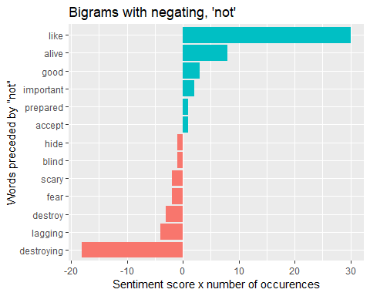
“Not” bigrams reverse AFINN sentiment scores

Slide 37
The “not” phrases add little to the tweet sentiment analysis
Too few to suggest impact
Frequent but ambiguous pairs, “not like” and “not alive”
Most sentiment words in the “not” bigrams are negative, reversed in meaning, support the prior positive sentiment results on the pool of tweets.

Slide 38
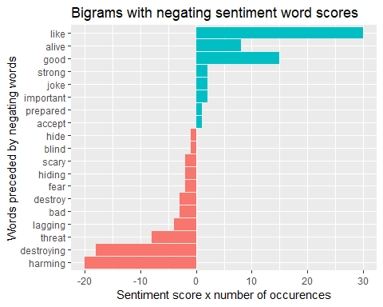
Additional negating words, “no,” “never,” and “without”

Slide 39
## Conclusion - Positive, Not Generalizable

Slide 40
Sentiment analysis finds positivity in tweets about AI
Sentiment expressed about AI was more positive than negative, over all lexicons in period.
Using NRC lexicon, the two most frequent specific sentiments were trust and fear words.
AFINN word sentiment scoring, calculating both total and average scores for a specific Tweeter, revealed more positive Tweeters than negative, in a bimodal distribution. (Few neutral Tweeters.)
Bigram analysis provided two results: ambiguous word pairs and positivity from negating first words.

Slide 41
More Exploration
Results likely would vary if the data were more representative of the general public with Twitter accounts. -I assume this 7-day snapshot of tweets are by users who routinely tweet about AI, which implies some technical knowledge. -Marketing tweets tend to be associated with positive sentiment language that could be filtered out by the name.
The final custom stop word list included technology companies and consultants.

Slide 42
Uses of the method
The same analysis could be used for generalizing to pubic sentiments:
a series of data snapshots, especially selected to capture an AI news event;
snapshots taken at intervals for revealing changes over time
term frequencies and term frequency-inverse document frequency (tf-idf) statistics could be utlitized at the snapshot level; and
more general public data would support topic identification within AI and prediction.

